Slide 1
Leading for Success
Cultivating Emotional Intelligence in OURSELVES and those we LEAD

Slide 2
Who am I?
Susan Cole, School Psychologist
Positive Culture & Climate Coordinator, New Hanover County Schools
Certified in the Assessment (EQ-i 2.0/EQ360) and Development of Emotional Intelligence

Slide 3
AGENDA
What you can expect during our time together
Introduction & Welcoming Activity
Agenda & Expectations
What is Emotional Intelligence?
The Research: What role does EI play in successful leadership?
Developing EI in Ourselves
Fostering EI in those we LEAD
Optimistic Closure

Slide 4
What I hope to be true after our time together:
We will have defined leadership in our own terms.
We will have explored what it means to be “self-aware”.
We will have considered what it takes to “self-regulate” effectively.
We will consider how our self-awareness and ability to self-regulate impacts our relationships with others.
We will reflect on how these skills lead to increased happiness and personal and professional success.

Slide 5
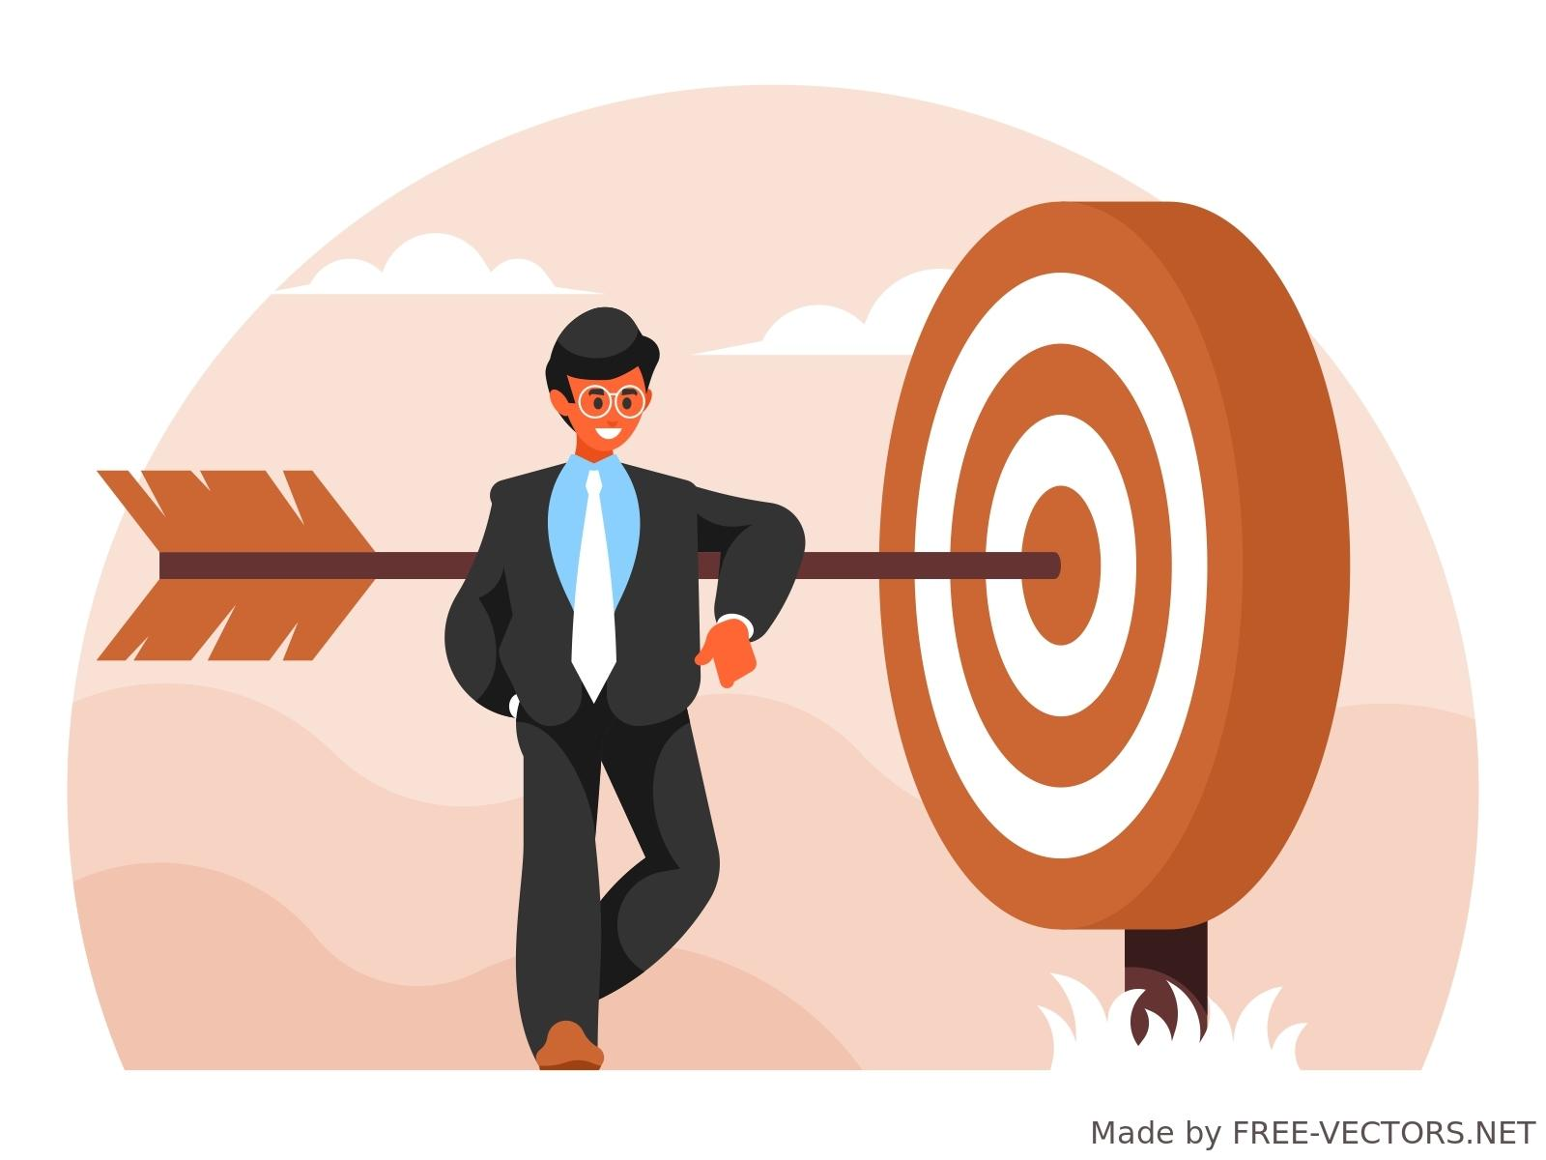
Guidelines for Success (our SHARED Agreement)
Be Present
Accept yourself as you are
Take a learners approach
Elevate your voice
Value the thoughts and opinions of others
Have fun

Slide 6
Welcoming Activity
Get to know each other
Prime our brains for the work ahead
What food(s) are nostalgic for you? Those that transport you to a specific time, place, or person?
Map out your leadership journey
Page 2 of your workbook

Slide 7
What makes someone a leader?
Notes:
Leadership is the result of action, if you act in a way that inspires, encourages or engages others, you are a leader. Create an environment that enables those around you to thrive.

Slide 8
What makes someone a GREAT leader?
What qualities or characteristics do GREAT leaders have?
What do Great leaders do?
Draw from your experience to jot down your answers on page 3 of your workbook
TURN & TALK
Notes:
What’s the difference between a leader and manager
Who determines whether someone is a leader?
Leaders create the context in which we work
How do good leaders learn these things?
The “follower” ?
The organizational chart?

Slide 9
What is Emotional Intelligence?
Often referred to as EQ but don’t confuse it with IQ!
Notes:
Goleman Definition, origination

Slide 10
Emotional Intelligence is..
To lead with emotional intelligence is to INSPIRE, MOTIVATE, and instill a SENSE of WORTH, BELONGING, and CONFIDENCE.
-David Cory, Leading with Emotional Intelligence (2010)
The ability to identify and manage emotional information in oneself and others and focus energy on required behaviors.
Return on Emotion: Predicting and Improving Human Performance (Feb. 2006) Durek & Gordon

Slide 11
What is Emotional Intelligence?
5 Main Components
Self-Awareness
Motivation
Self-Regulation
Empathy
Social Skills
Recognize Emotions
Understand Your Strengths & Weaknesses
Self-Actualization
Goal Setting
Manage Emotions
Cultivate Positivity & Resilience
Perspective Taking
Recognize Emotions in Others
Communicate Effectively
Resolve Conflicts
Notes:
https://online.hbs.edu/blog/post/emotional-intelligence-in-leadership
Daniel Goleman: EQ Theory

Slide 12
Emotional Intelligence in the WorkPlace by the NUMBERS
71%
58%
75%
Of Employers value Emotional Intelligence OVER Technical Skills
Of Job Success is Attributed to Emotional Intelligence
Of Fortune 500 Companies use Emotional Intelligence Testing and Training
Notes:
https://press.careerbuilder.com/2011-08-18-Seventy-One-Percent-of-Employers-Say-They-Value-Emotional-Intelligence-Over-IQ-According-to-CareerBuilder-Survey
https://www.forbes.com/sites/forbesbusinesscouncil/2022/05/04/adopting-emotional-intelligence-in-the-workplace-is-more-than-a-nice-to-have/?sh=69f001425560
https://zipdo.co/statistics/emotional-intelligence/#:~:text=Highlights%3A%20The%20Most%20Important%20Statistics,emotional%20intelligence%20training%20and%20testing.

Slide 13
Leading with EMOTIONAL INTELLIGENCE
Leads to Personal & Professional Success
Fosters Positive & Supportive Work Environments
Leads to Increased Productivity
Yields Higher Rates of Employee Retention
Creates Greater job satisfaction
Results in Improved Resilience and Overall Wellness
https://hbr.org/2001/12/primal-leadership-the-hidden-driver-of-great-performance

Slide 14
The FOCUS of our work TODAY
01
02
03
Self-Awareness
Self-Regulation
Relationship Management
Values
Strengths & Weaknesses
Emotion/Stress Management
Optimism & Motivation
Communication
Empathy
Notes:
https://press.careerbuilder.com/2011-08-18-Seventy-One-Percent-of-Employers-Say-They-Value-Emotional-Intelligence-Over-IQ-According-to-CareerBuilder-Survey

Slide 15
What is SELF AWARENESS?
Generally Speaking
Specifically….
Self-awareness is the ability to identify and understand one’s emotions, thoughts, and values and how they influence one’s behavior.
Identifying Emotions
Identifying Values
Recognizing Strengths & Limitations
Linking feelings to behavior
Identifying personal and cultural assets
Developing a sense of purpose and efficacy
What role does self-awareness play in LEADERSHIP?
Notes:
High self-awareness helps with perspective taking and recognizing the emotions of others, leads to better decision making and more effective problem solving.
Self Awareness Quiz

Slide 16
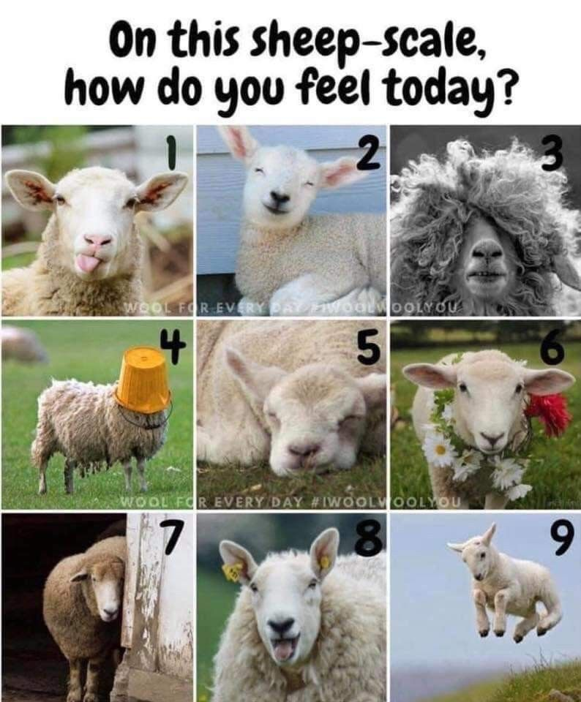
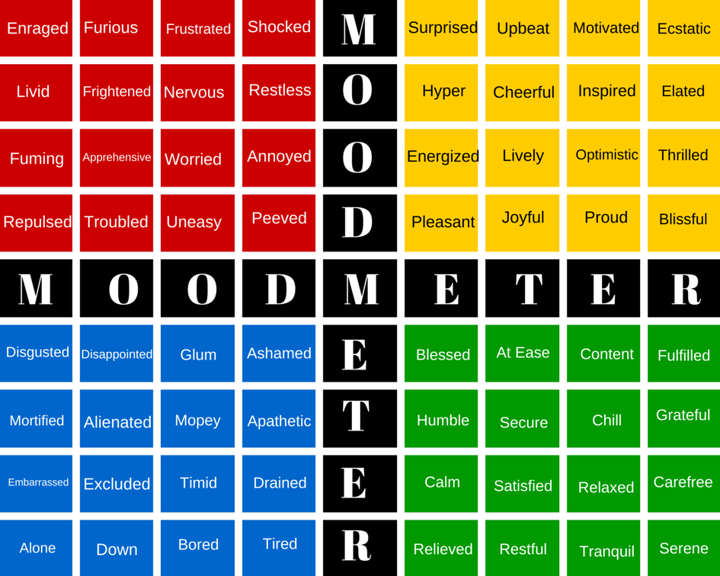
Emotion Check IN: How are you feeling right now?

Slide 17
Who are you?
“WHO we are is how we LEAD
-Brene Brown
Activity:
Identifying your core VALUES

Slide 18
Activity: Identifying CORE VALUES
3 minutes: Underline your TOP 10 VALUES
3 minutes:
Narrow your list by CIRCLING your TOP 5 VALUES
3 minutes:
Narrow your list by placing a STAR by your TOP 3 VALUES
Which one of your top 3 CORE VALUES is most EVIDENT in your Leadership? How does it “show up” in your work?
Notes:
What happens when our core values are not aligned with our actions?

Slide 19
Our Values in “ACTION”
“The truth of the matter is that you always know the right thing to do. The hard part is doing it. “
-Norman Schwarzkopf, General, Commander
Value Integrity
Value Contribution
I practice what I preach
I do what I say I’ll do
I am accountable for my actions
I look for ways to add value in work and life
I do not hesitate to use my strengths and talents

Slide 20
What is Self Regulation?
Generally Speaking...
Self regulation is the ability to effectively manage one’s emotions, thoughts, and behaviors in a variety of situations in order to reach goals.
Specifically:
Manage emotions
Manage stress
Exhibit self-discipline and motivation
Set goals
Plan & Organize
Take initiative
Notes:
Self-Regulation Self-Assessment

Slide 21
“Between stimulus and response there is a space. In that space is our power to choose our response. In our response lies our growth and our freedom.”
-Unknown
How do you create the space you need to self-regulate and align your leadership with your values?
Notes:
Activity in Workbook

Slide 22
What do you believe?
In your experience, does professional and/or personal success lead to feelings of happiness or do feelings of happiness lead to success?
Notes:
Split the room Activity

Slide 23
Optimism and Motivation
“Happiness is a mindset for your journey, not the result of your destination.”
-Shawn Achor, The Happiness Advantage (2010)
The Happiness Advantage
Consider this:
Happiness is not the belief that we don’t need to change, it’s the realization that we can.
-Shawn Achor
Notes:
Positive feelings are an antidote to stress and anxiety

Slide 24
What is Relationship Management?
Generally Speaking..
The ability to establish and maintain healthy and supportive relationships and navigate settings with diverse individuals and groups.
Specifically:
Communicate effectively
Practice teamwork & collaborative problem solving
Resolve conflicts
Seek and offer feedback and support as needed
Notes:
Relationship Skills self assessment

Slide 25
Communication is KEY
Be Aware of Your Body Language
Engage in Active Listening
Use language that Builds Relationships
Listen Without Judgement
Avoid Making Assumptions
Choose Words that Express Care/Understanding
Plan for difficult conversations!
Notes:
Active listening, take the time to understand perspectives, wants, needs, thus boosting engagement, build trust, and problem solve challenges.

Slide 26
Let’s Practice
Active Listening Activity
60 Second Monologue: Describe your leadership journey to your neighbor.
Switch Speakers

Slide 27
Putting it all together
SELF-
REGULATION
SELF AWARENESS
RELATIONSHIP MANAGEMENT
Leading with Emotional Intelligence is an INTEGRATED EXPERIENCE

Slide 28
As leaders, how can we develop these competencies in those we lead?
MODEL
REFLECT
KNOW WHO YOU ARE
BE INTENTIONAL
ADJUST
AS NEEDED
GIVE & RECEIVE FEEDBACK

Slide 29
Optimistic Closure
How can you plan to take this motion and create ACTION?
What is your FIRST, INTENTIONAL step?
CONGRATULATIONS!
You have created motion today!
WANT TO CONNECT?
susan.cole@nhcs.net

Slide 30
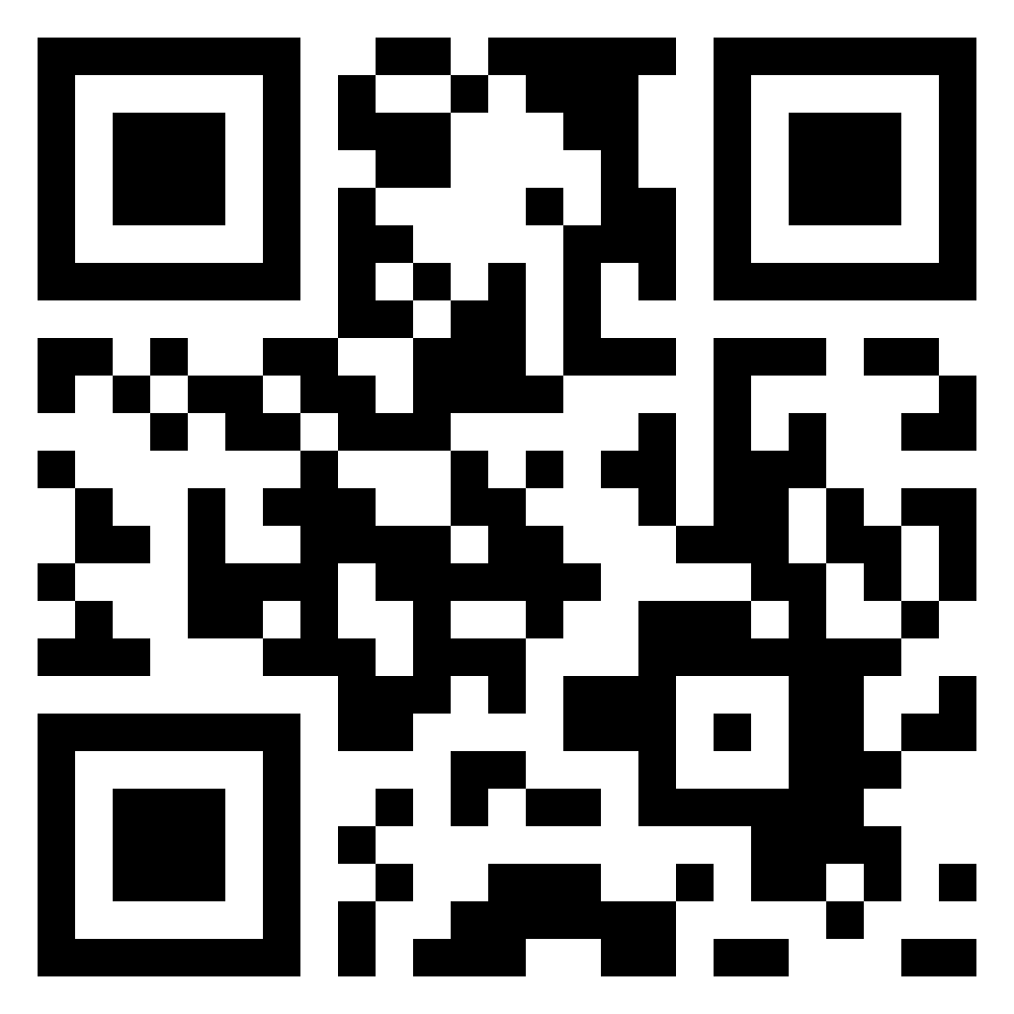
Feedback Survey
Your perspective is important to me! Thank you for your time!

Slide 31
RESOURCES
Books:
Achor, S. (2010) The Happiness Advantage. Currency
Aguilar, E. (2016) The Art of Coaching Teams. Jossey-Bass
Brown, B. (2018) Dare to Lead. Penguin Random House LLC
Clear, J. (2018) Atomic Habits: Tiny Changes, Remarkable Results. Avery
Websites:
www.CASEL.org The Collaborative for Academic, Social, Emotional Learning

